Slide 1
Data Science
By Owais Ahmed Khan

Slide 2
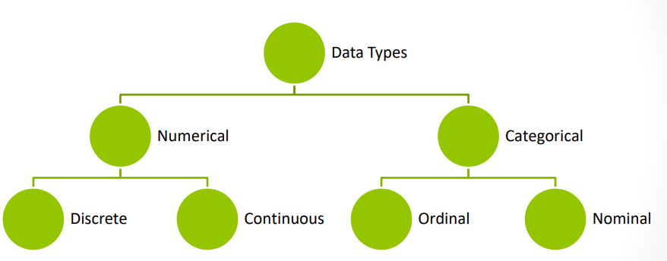
Types Of Data
There are two types of variables you’ll find in your data – numerical and categorical.

Slide 3
Numerical Data / Quantitative Data
Quantitative data consists of numerical measurements or counts.
Discrete Data:
Discrete data consists of distinct, separate values with no intermediate values between them.
Examples:
number of siblings (1, 2, 3)
number of employees in an office.
number of cars in a parking lot
number of faculty members in a meeting.

Slide 4
Numerical Data
Continuous Data:
Continuous data represents measurements that can take on any value within a given range.
Examples:
Height
Weight
Temperature
Time

Slide 5
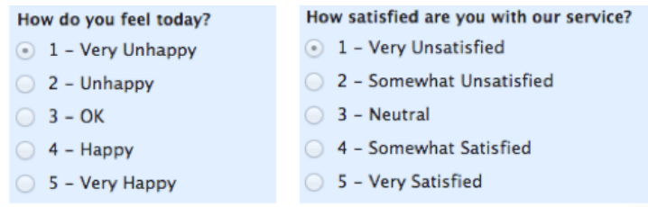
Categorical Data
For categorical data, this is any data that isn’t a number, which can mean a string of text or date. These variables can be broken down into nominal and ordinal values.
Ordinal values are values that have a set order to them. Examples of ordinal values include having a priority on a bug such as “Critical” or “Low” or the ranking of a race as “First” or “Third”.

Slide 6
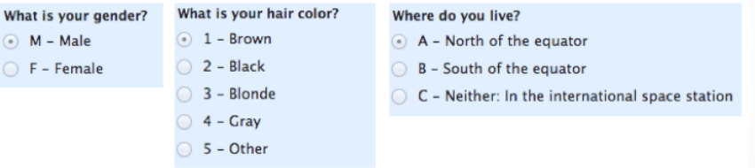
Categorical Data
Nominal values are the opposite of ordinal values, and they represent values with no set order to them. Nominal value examples include variables such as “Country” or “Marital Status”.

Slide 7
Forms of Data
Structured Data: Organized in a tabular format with rows and columns, such as CSV files, Excel spreadsheets, and SQL databases.
Unstructured Data: Doesn't have a predefined format or structure, such as text documents, audio, images, and videos.
Semi-structured Data: Has a partially defined format but doesn't fit neatly into tables, such as PDF files , HTML pages, etc.

Slide 8


